Slide 1

Phonebook management system
Made by
KRISH S. PATEL
21162171023 CS B-25

Slide 2
Phonebook management system program in cpp
Concepts used in this program
1. file and streams
2. class and objects
3. switch case

Slide 3
Header file used in this program
<iostream> : header file declares a set of functions for standard Input/Output. It also defines I/O stream objects such as cin, cout, etc.
<conio.h> : console input output
<fstream> : file and streams This data type represents the file stream generally, and has the capabilities of both ofstream and ifstream which means it can create files, write information to files, and read information from files.
<stdio.h> The header file stdio.h stands for Standard Input Output. It has the information related to input/output functions

Slide 4
Program menu
1. save new record
2. display all saved records
3. search specific record
4 delete specific record
5. Modify existing record
6. exit

Slide 5
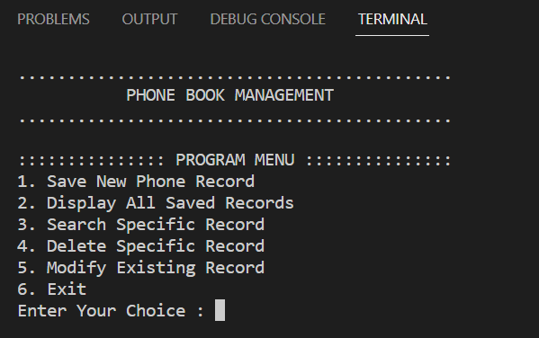
Output program menu screen
.

Slide 6
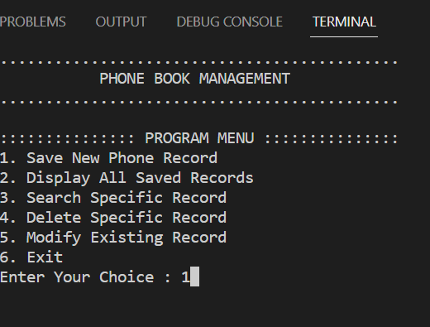
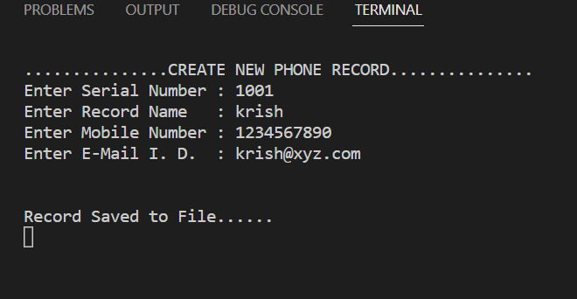
Choice 1 add new phone record

Slide 7
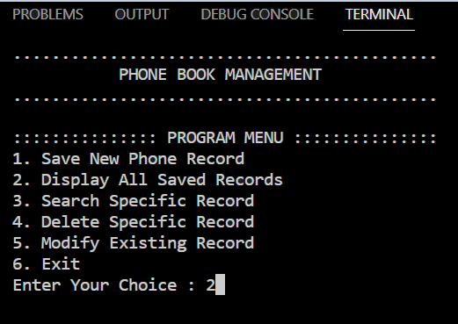
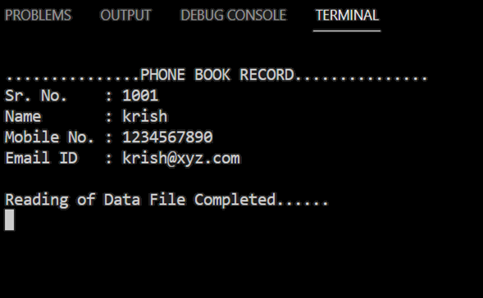
Choice 2 display all saved records

Slide 8
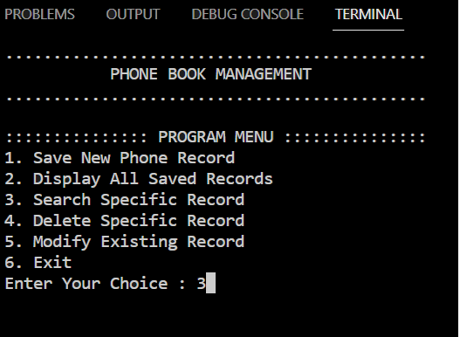
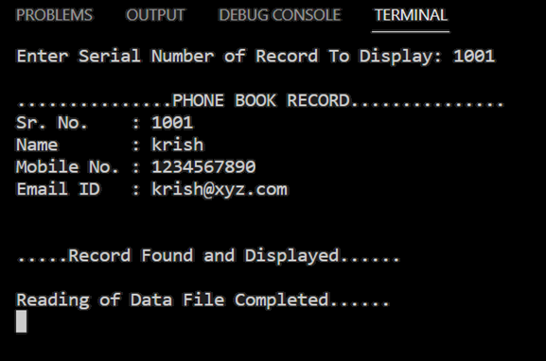
Choice 3 search specific record

Slide 9
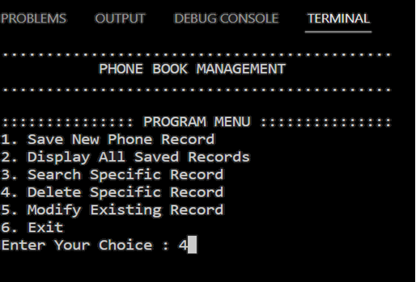
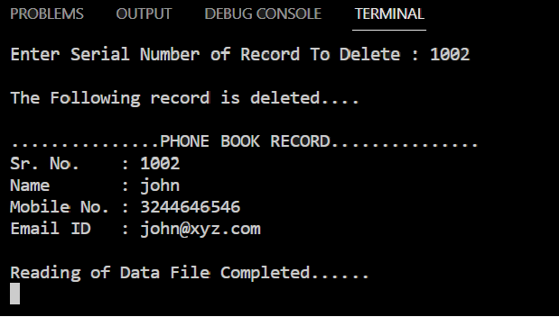
Choice 4 delete specific record

Slide 10
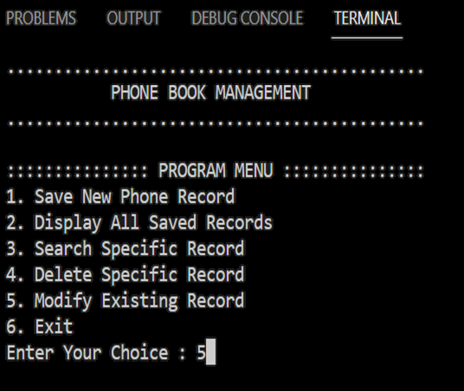
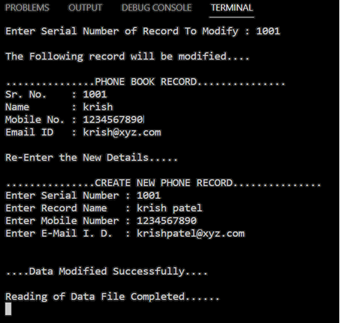
Choice 5 modify existing record

Slide 11
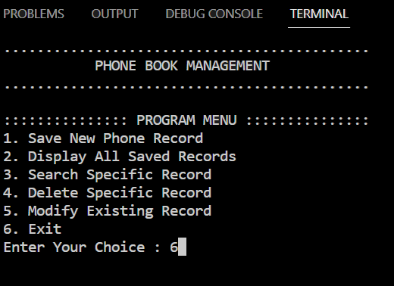
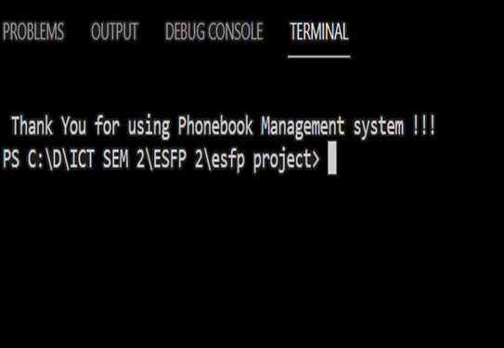
Choice 6 Exit

Slide 12
Thank you

